Slide 1
Highways Safety Hub
Blue Star award ideas
This presentation includes a selection of innovative ideas / suggestions for improvement

Slide 2
Blue Star awards presentation - Part 2
PPI
(Plant Person Interface)

Slide 3
Index listing of Blue Star awards (page 1 of 5)
B000 - Plant person interface, good practice
B001 – Diphoterine
B002 - Traffic management
B003 – Health Wellbeing (Champion)
B004 – Work on bridge deck / Wind monitoring system
B005 – Safetime scaffold tags
B006 – BIM
B007 – RAG batter
B008 – Water mist fire extinguisher
B009 – Smart screens
B010 – Mission Room
B011 – Controlling permits to work
B012 – WAH / Load and unload vehicles
B013 – Gridforce 30
B014 – Dumper camera
B015 – Excavator stickers
B016 – Chapter 8 chevrons
B017 – Occupational health (3 year plan)
B018 – TM airlock
B019 – Health, safety, wellbeing strategy
B020 – Training

Slide 4
Index listing of Blue Star awards (page 2 of 5)
B021 – Readi-guard (RO) TM airlock gates
B022 – Bunkabin accommodation
B023 – Competence
B024 – Technology to improve safety (BIM)
B025 – Red Zone training
B026 – Public route planning
B027 – Safety pegs to maintain TBS zone
B028 – Control of vehicles leaving site
B029 – Vehicle payload and weights sheet
B030 – Message boot laces
B031 – Google maps S&O planning
B032 – LGV enforcement
B033 – HAVwear watches
B034 – LED lights on goal posts
B035 – Briefing document (daily)
B036 – Call button for ped access to site
B037 – QR codes and NFC readers
B038 – Skipper tape exclusion zone
B039 – Value engineering
B040 – Improving communication

Slide 5
Index listing of Blue Star awards (page 3 of 5)
B041 – Incident investigation
B042 – TM (influencing drivers / body cams)
B043 – PatrolLive
B044 – Work behind access and exit points
B045 – Control of HAVS (PAM breaker)
B046 – Safety gates
B047 – Works access gate (WAG)
B048 – Site security)
B049 – A duplication of BS Award 43
B050 – A duplication of BS Award 44
B051 – Animated RAMS
B052 – Yellow mat
B053 – SMART SITE monitors
B054 – Vest and helmet lights
B055 – TM works order management system
B056 – TM nightshift isolation plan
B057 – Service avoidance
B058 – 2-way radios, key info, dumper cam
B059 – Use of stop gates
B060 – Plant person interface training

Slide 6
Index listing of Blue Star awards (page 4 of 5)
B061 – Induction training area 1
B062 – PPI, JCB Hydradig, Prolec restrictors
B063 – LifeVac
B064 – Virtual reality (VR) training
B065 – Rotating dumper cab
B066 – Surface mining (use of Power Plane)
B067 – Occupational health, fatigue
B068 – Service avoidance
B069 – Overhead protection
B070 – Banners (bridge name / No / location)
B071 – Remote drilling (No HAVS)
B072 – MEWP virtual reality training simulator
B073 – Drone tech aerial mapping stockpiles
B074 – Halo Deployment ‘Worker Guardian’
B075 – Base Light 420x portable lighting
B076 – Virtual reality PPI training
B077 – Hi-vis dumper
B078 – Milwaukee 6232 Band saw
B079 – GTL gas to liquids fuel
B080 – VMS overhead protection

Slide 7
Index listing of Blue Star awards (page 5 of 5)
B081 – VMS TM exit
B082 – Trimble site vision
B083 – Survey giraffe
B084 – Public pedestrian safety
B085 – Emergency call button
B086 – V2 VDZ System
Blue Star awards, issued by calendar year:
2015 – 11no.
2016 – 44no. (+2no. Duplicates)
2017 – 12no.
2018 – 11no.
2019 – 2no.
2020 – 3no.
2021 –
Total = 83no.

Slide 8
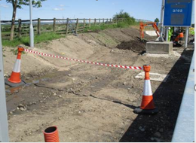
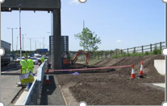
B000 – Skipper retractable tape
Skipper retractable tape used for demarcation.
Photos (left), show how Skipper tape has been used to demarcate a plant exclusion zone.

Slide 9
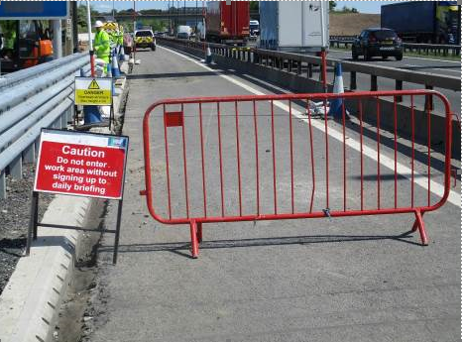
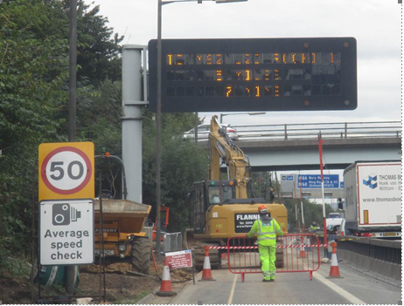
B000 – Safety Gate
A Safety Gate, as pictured left, is placed across the haul road on the approach to work areas, to prevent unauthorised or mistaken access whilst works were being carried out.
The Safety Gate is opened and closed by a plant and vehicle marshal, to allow vehicles and personnel to pass safely, as soon as practicable.

Slide 10
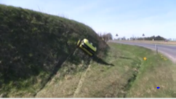
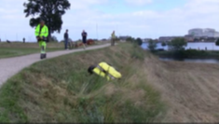
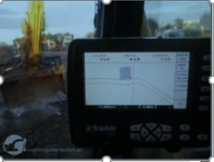
B012 – Work at heights
Some plant has been fitted with GPS to avoid the need for setting out engineers to work at height on batters
Permanent fencing was installed early along the top of cuttings to prevent falls from height, and during the summer, a remote controlled mower was used to cut the grass on some of the steep embankments to reduce the risk of S/T/F’s

Slide 11
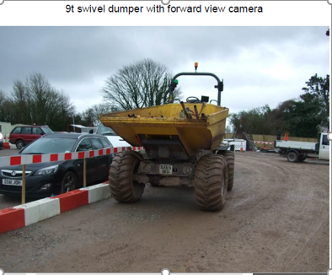
B014 – Dumper camera
Dumper camera:
A Neuson 9T Swivel Tip Dumper has been fitted with a forward looking camera below the tipping skip to provide the driver with a clear view of what is in front of the dumper.
This dumper is also fitted with a green light which identifies when the driver has his seat belt on.

Slide 12
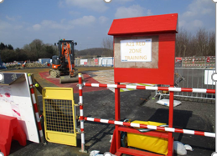
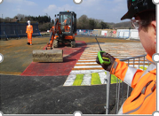
B025 – Red Zone training
Good work on PPI.
At induction, Red Zone training area set up, use of videos and models to demonstrate zones.
Boards showing plant and vehicle movements, footpaths and pedestrian walkways in place, control of pedestrians where large plant is operating, gate access controlled by vehicle marshals
Visits to CAT and JCB factories.
Red Zone training area in main compound
Red Zone training demonstrating button to stop plant

Slide 13
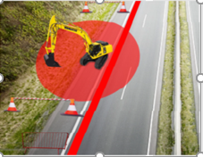
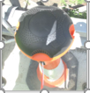
B038 – Skipper tape exclusion zone
Skipper units are fitted to the top of cones and tape is pulled out up to 9m in length
A receiver unit is then placed on top of a cone that the tape fits into.
This provides a physical barrier (exclusion zone) but does not replace the barrier system
It is used to prevent unauthorised or mistaken access until work areas, are safe to enter

Slide 14
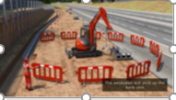
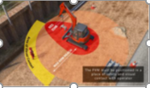
B051 – Animated RAMS
In October 2016, when the Blue Star was awarded, animated RAMS were being developed;
To show the workforce how activities should be carried out safely what equipment should be used, how the work area should be set up, and where operatives should stand etc.
This is particularly useful for briefing to workers who’s 1st language is not English, as it helps to overcome language barriers.

Slide 15
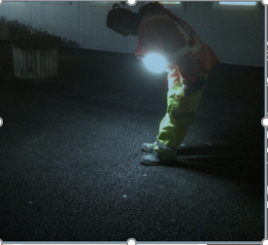
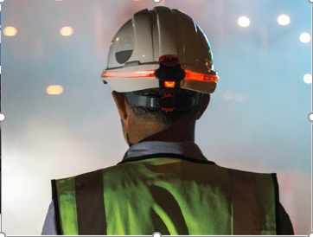
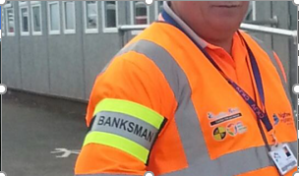
B054 – Vest and safety helmet lights
Improvements to the quality of PPE has included
A light vest to improve visibility of night workers,
LED and fibre optic helmet light to ensure black helmets are visible at night,
High visibility arm band to identify banksmen

Slide 16
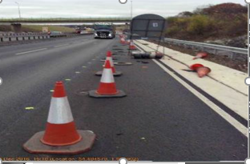
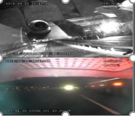
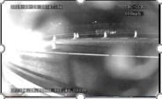
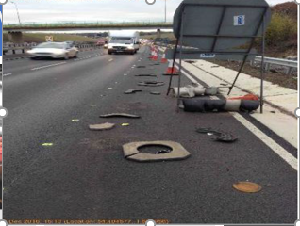
B055 – 360° cameras fitted to TM vehicles
360° cameras fitted to TM vehicles provide real time images whilst they are working on site.
These live images can be reviewed at any computer screen connected to the internet, these lives feds can be viewed via mobile devises and desk top computers.

Slide 17
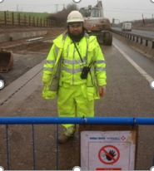
B058 – Two way radios
Two way radios - for communication between the plant operator and the plant and vehicle marshal.
Users of the radios explained that the radios worked extremely well and that they were comfortable with their use

Slide 18
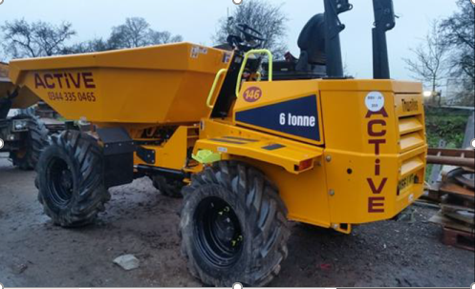
B058 – New 6T Dumper
New 6 Tonne Dumper –
Fitted with a forward facing camera, an advanced VCAS system, speed restrictor which has one key and once the speed has been set the key is kept in a secure cabinet, highlighted steps and handrail and a seatbelt which unless it is correctly fastened around the driver will disable the starter.

Slide 19
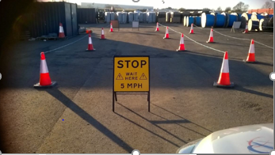
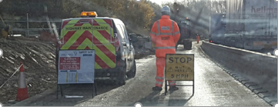
B059 – Use of stop gates
On 10 Oct 2016, a 6T Forward Tipping Dumper came into contact with a member of the workforce, resulting in a fatality.
This blue star was awarded for the collective measures put in place by the site and the performance of the site in response to the incident.
Measures incident use of stop gates.
Use on site
Mock demonstration

Slide 20
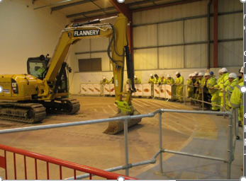
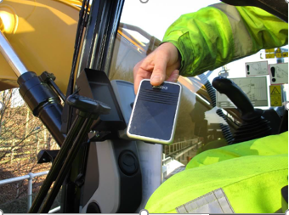
B060 – PPI training
Blue star awarded for proactive approach to PPI, including:
Training conducted by works manager
Bell push button for ganger to speak with plant operator
Dumper permit (to use)
Project light vehicle reversing procedure, including use of a short video clip.

Slide 21
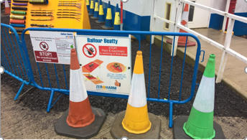
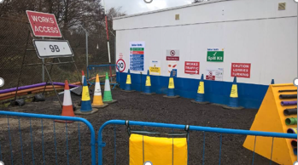
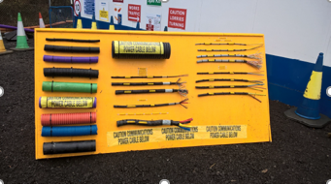
B061 – Induction training area 1
Induction introduced by a member of the Senior Management Team
Test at the end of induction, to ensure key points have been understood.
An area set up outside in the compound is to show and explain various initiatives including coloured road cones, goalposts, safety stations, spill kits, work access signage, and stop gates.

Slide 22
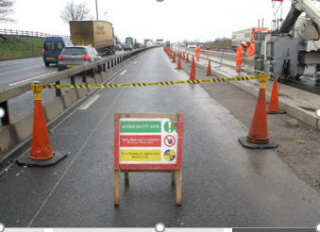
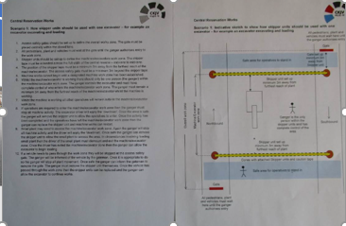
B062 – Stop boards and ‘Skipper’ tape
Stop boards and ‘Skipper’ tape on approach to work areas
Notes and Diagrams showing use of stop boards and skipper tape for different working scenarios

Slide 23
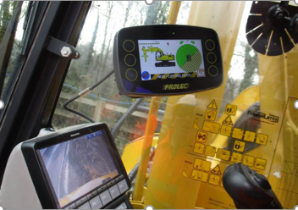
B062 – Prolec height and slew restrictors
Prolec height and slew restrictors –
Have been fitted to all plant on site.
In addition, 2 lorry mounted MEWP's have been fitted with slew restrictors to prevent the risk of them basket or boom swinging out over the live carriageway and coming into contact with MOP road users.

Slide 24
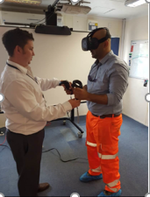
B064 – Virtual Reality Training
The site is developing Virtual Reality training for Plant Person Interface training.
It fully immerses the individual into a virtual environment that they can walk around, and if they walk too close to a machine, an alarm and a flashing light goes off to notify them that they are too close.

Slide 25
B064 – Virtual Reality Training
The site has already used 360° cameras to improve workforce awareness of what it is like to be on site adj. to significant activities, such as bridge lifts, and to give operatives an awareness of what plant operators can see from inside the cab.
No photo available

Slide 26
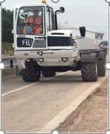
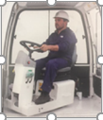
B065 – Rotating Dumper Cab
The 180° degree rotating seat and controls allow for added visibility and reduction in plant person interface issues.
In addition, the dumper skip swivels through 90° to avoid excessive movements, a function that similar items of plant do not currently have.
Query remains re comment: There is no need for the operator to leave the cab for loading or unloading?

Slide 27
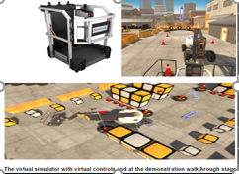
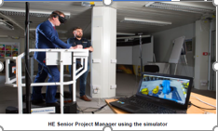
B072 – MEWP virtual reality training simulator
MEWP virtual reality training simulator:
Introduction of ground-breaking virtual reality simulators are designed to allow operators a true-to-life look and feel of operating an access platform in a safe and controlled environment.
The Simulator realistically simulates the sensation of boom and scissor operations.

Slide 28
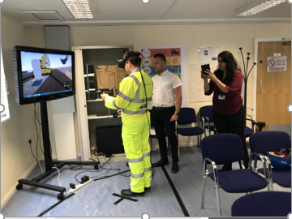
B076 – Virtual Reality PPI training
Virtual reality PPI training:
Places a person virtually into a construction scenario where an excavator is digging into the embankment and filling up a nearby wagon
The goal is to highlight red and amber danger zones around the plant, never pass behind the excavator and to reinforce gaining permission from the plant driver to pass by.

Slide 29
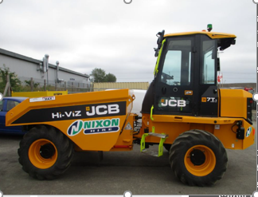
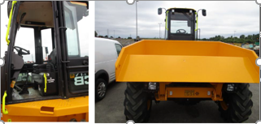
B077 – Hi-vis Dumper
Hi-vis dumper –
Utilises a structural cab which reduces the risk of falls from vehicles as the dumper can be loaded with the driver secured in the cab.
In addition, the sloped skip front and lower skip position increases forward visibility and reduces the blind spot to 1m high and 1m away from the skip.
Good decals increase the safety for the driver.

